Slide 2
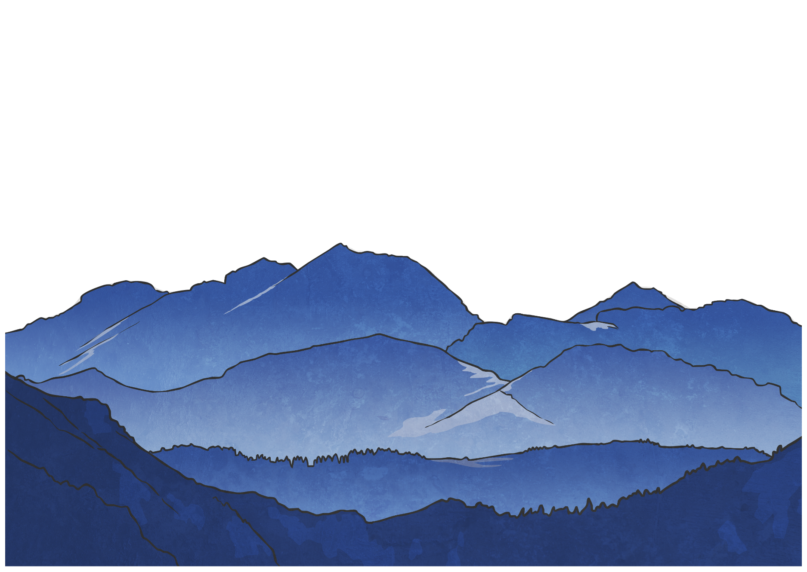
Mount Olympus
The ancient Greeks believed in many different gods and goddesses. The most powerful 12 lived on the top of Mount Olympus. This is where meetings were held and arguments were settled.
There were some very powerful gods who did not actually live on Mount Olympus, such as Hades, god of the underworld.

Slide 3
Zeus
Zeus was the most powerful of all the gods. He was god of the sky and the King of Mount Olympus.
He was married to the queen of the gods, Hera, but he had many other lovers.
His temper affected the weather, and when he was angry he threw thunderbolts.
Did you know?
Zeus’ father was worried that his children would betray him, so he ate them. Zeus’ mother tricked his father and gave him a rock to eat so Zeus was free.

Slide 4
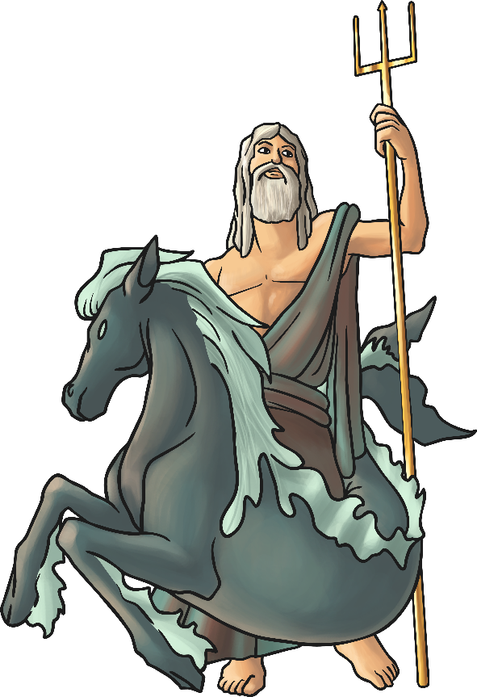
Poseidon
Poseidon was the god of the sea. He was the most powerful god except for his brother, Zeus.
He lived in a beautiful palace under the sea and caused earthquakes when he was angry.
Poseidon delayed the return of Odysseus from the Trojan War by causing his boat to be shipwrecked.
Did you know?
He rode a chariot pulled by seahorses.

Slide 5
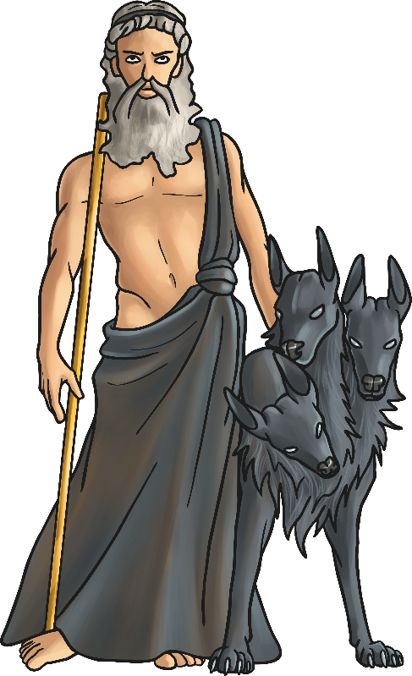
Hades
Hades was the brother of Zeus. The ancient Greeks were quite afraid of him.
Hades was the god of the dead. He ruled the underworld, where people went when they died.
People made sacrifices to Hades when they wanted something bad to happen.
Did you know?
He was also the god of wealth because of the precious metals mined from the earth.

Slide 6
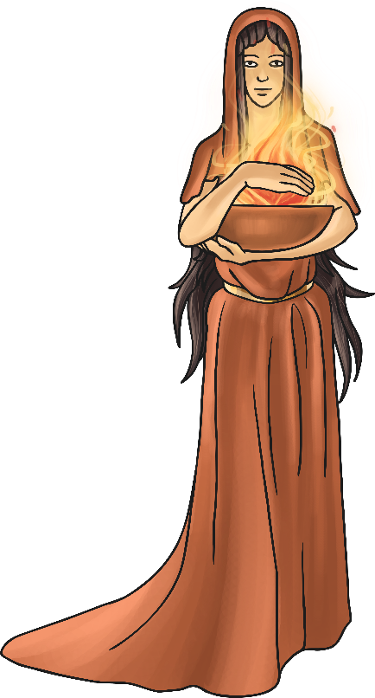
Hestia
Hestia was Zeus’ sister.
She was the goddess of the house and of the hearth (the fireplace in a house).
Hestia was deeply honoured by ancient Greek women.
Did you know?
There aren’t many myths about Hestia.

Slide 7
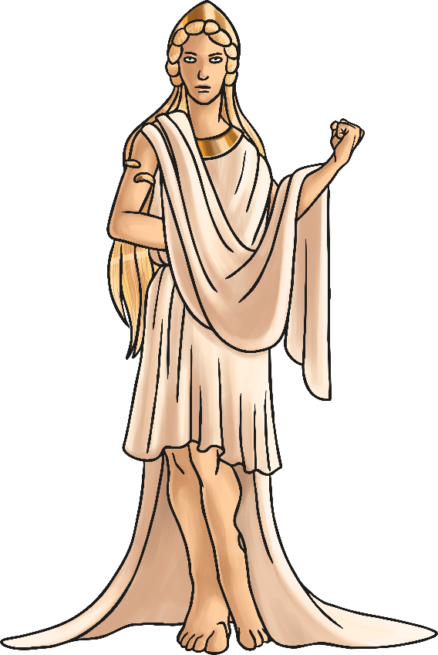
Hera
Hera was the sister and wife of Zeus. She was powerful and beautiful but very jealous and vain.
Hera was an Earth goddess and the goddess of family and marriage.
She tried to kill Zeus’ son Heracles (also known as Hercules).
Did you know?
She was on the side of the Greeks in the Trojan War but Zeus sided with the Trojans. She deceived and distracted her husband, so that the Greeks had the upper hand during the Trojan War.

Slide 8
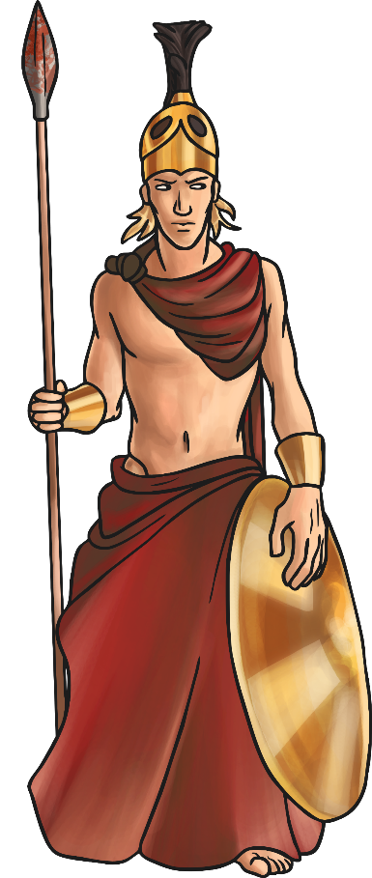
Ares
Ares was the god of war. He was cruel and a coward.
Ares was the son of Zeus and Hera and they did not like him.
He killed the giant Ekhidnades, a fierce monster and enemy of the gods.
Did you know?
His throne was upholstered by human skin.

Slide 9
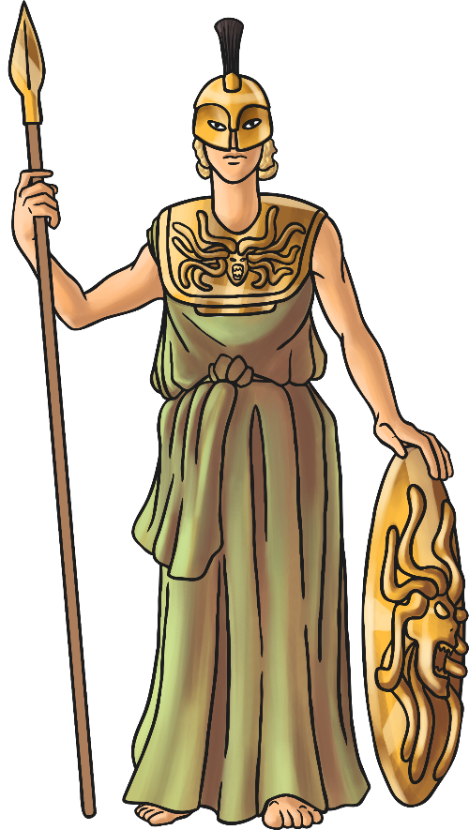
Athena
Athena was the daughter of Zeus. She was born directly out of his forehead. She was Zeus’ favourite child.
She is the goddess of reason, intelligence, art and literature.
Athena turned Medusa from a human into a monster.
Did you know?
The city of Athens is named after Athena. The Parthenon is her best known and best preserved temple.

Slide 10
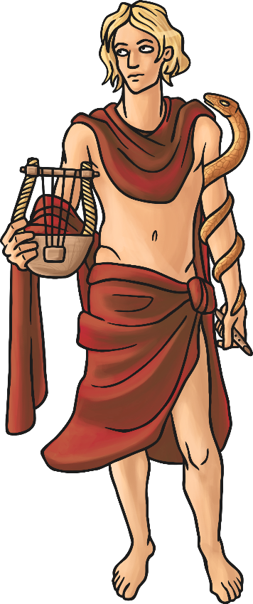
Apollo
Apollo was the son of Zeus and the twin brother of Artemis.
Apollo was the Sun god. He was responsible for the movement of the sun across the sky. He moved the sun with a chariot pulled by golden horses.
He was also the god of archery, prophecy, and music.
Did you know?
Apollo had healing powers.

Slide 11
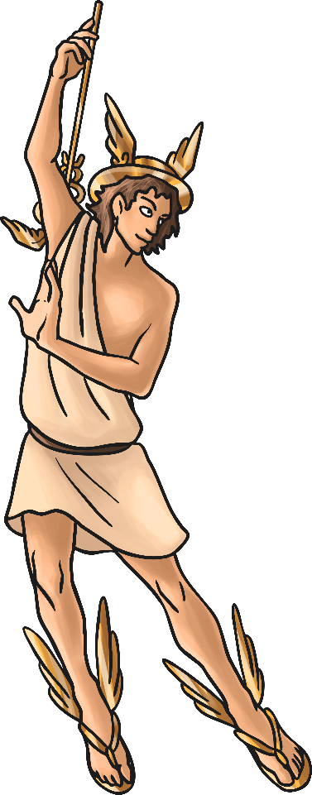
Hermes
Hermes was Zeus’ youngest son. Hermes was very fast on his feet and clever so Zeus decided to make him a messenger.
Hermes always knew everything going on in the mythical world.
The other gods trusted Hermes. He was very clever and loyal and was a very good negotiator.
Did you know?
Many ancient Greeks believed that Hermes was responsible for the invention of the alphabet, boxing and gymnastics.

Slide 12
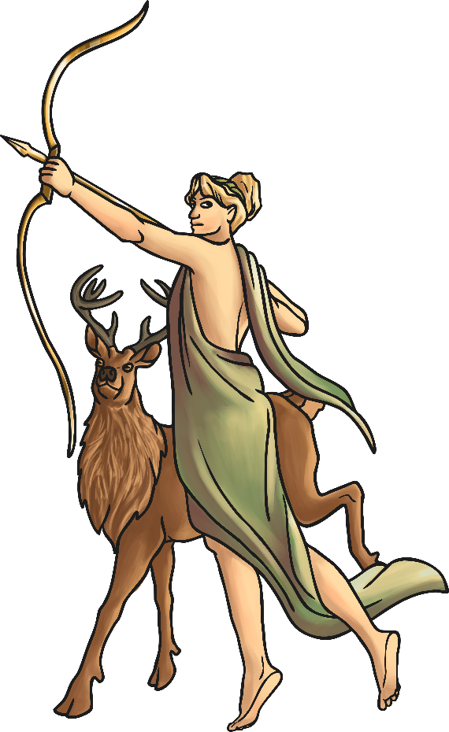
Artemis
Artemis was the daughter of Zeus and the twin sister of Apollo.
She was a moon goddess responsible for the movement of the moon across the sky at night. She moved the moon in a chariot pulled by stags.
She was also a huntress and the protector of animals and young children.
Did you know?
A hunter was caught spying on Artemis when she was bathing. As a punishment, Artemis turned him into a stag and set his own hunting dogs after him.

Slide 13
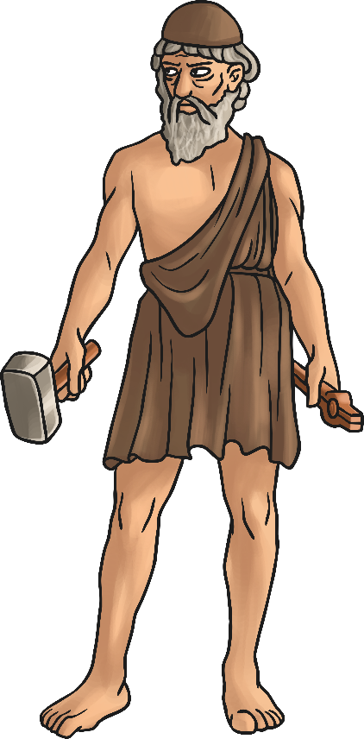
Hephaestus
Son of Hera and Zeus. Husband of Aphrodite. Hephaestus was the god of forge and fire. Hephaestus fell to the earth and was nursed back to health.
Living on earth he began his career of craftsmanship, forging lots of amazing things from metal and other materials.
He later returned to Mount Olympus where he continued to make magnificent objects
Did you know?
He was the only Greek god who had a normal job and worked with his hands.

Slide 14
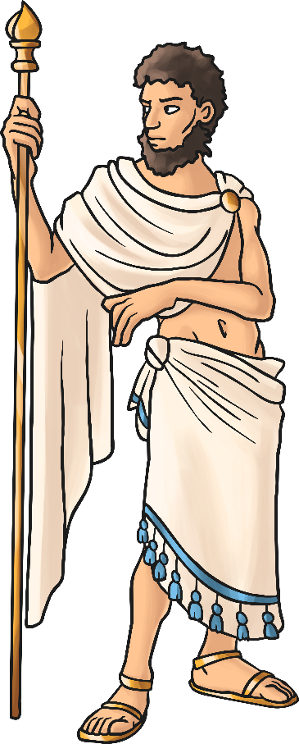
Uranus
He was the god of skies. He had six sons and six daughters called the Titans. The generation before the Olympian gods.
He was killed by his son because he had rejected his children.
His blood fell into the sea and Aphrodite emerged out of the sea foam.
Did you know?
The planet Uranus is named after the god Uranus. Some people think that the rich blue skies surrounding the planet resemble the god of skies.

Slide 15
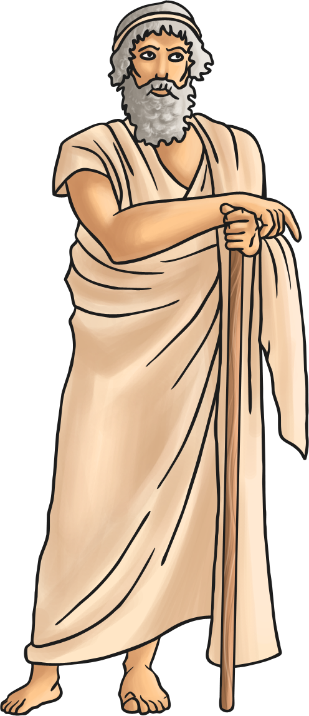
Chronos
Chronos was the god of time and the ages. He was a representation of the past, future, and eternity.
He was a snake like form with three heads but is always pictured as an old man.
He is also known as Father Time.
Did you know?
Some English words derive from his name such as chronicle, chronology and chronic.

Slide 16
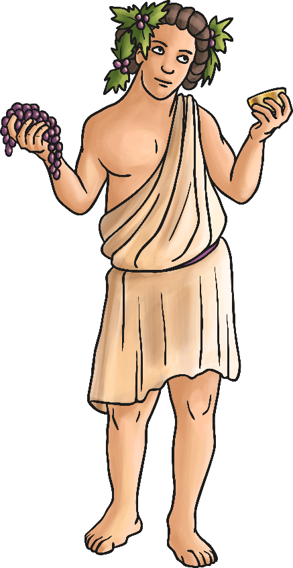
Dionysus
Dionysus was the son of Zeus. He was god of fertility and wine.
He invented wine and encouraged the making of wine.
His personality reflected the nature of wine, he could bring joy but also bring rage.
Did you know?
He is one of the very few to bring a dead person back from the underworld.

Slide 17
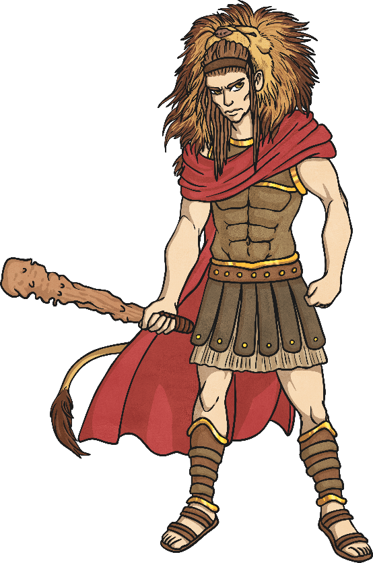
Heracles
Heracles was the son of Zeus and a woman named Alcmene, and is also known as Hercules.
He was born on Earth. He was a great hero and very strong. Even when he was a baby.
Heracles grew up to be the strongest man in the world. He later became a god.
Did you know?
When Heracles was a baby Hera sent two large snakes to kill him, however Heracles strangled the snakes in his crib.

Slide 18
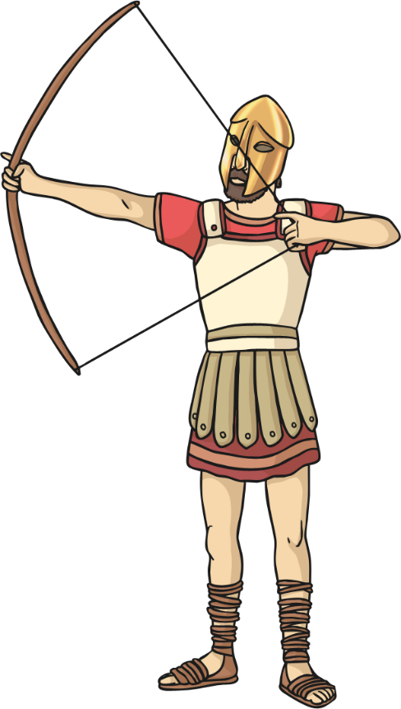
Eros
Eros was son of Aphrodite, the goddess of love and beauty. Eros was very romantic and full of mischief.
He made people fall in love by shooting arrows which made the victim fall in love with whoever they saw next.
He often found amusement by making unmatched people fall in love. He was the youngest god.
Did you know?
Eros fell in love with Psyche (a mortal) when he grazed himself with his own magic arrow. Psyche was made immortal so that they could be together.

Slide 19
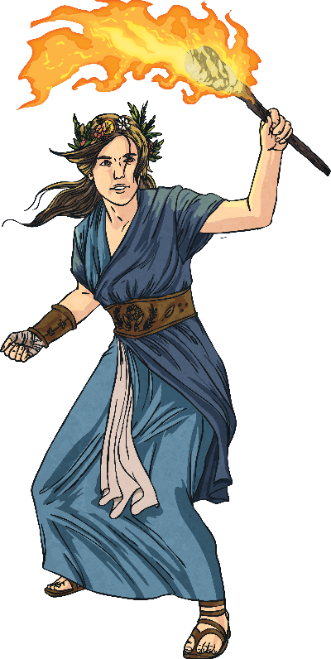
Demeter
Demeter was the daughter of Chronos, the god of time and the ages. She is the goddess of the harvest, law and fertility.
She was worshipped by the people as she controlled the growth of crops. If she was angry, then she could stop crops from growing and people would go hungry.
She had many children, including Persephone, goddess of the springtime, and Arion who was a fast, immortal, flying and talking horse.
Did you know?
Demeter rode in a chariot pulled by dragons and carried a long golden sword in battle.

