Slide 2
Aim
I can explain how the political system worked in Ancient Greece.
I can compare this system with other political systems.
Success Criteria
I can explain what democracy is.
I can explain if I think different systems of democracy are fair or not and give reasons.
I can compare ancient and modern democracy.
I understand the legacy of the Athenian democratic system.

Slide 3
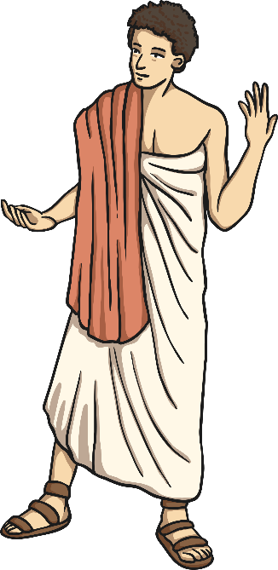
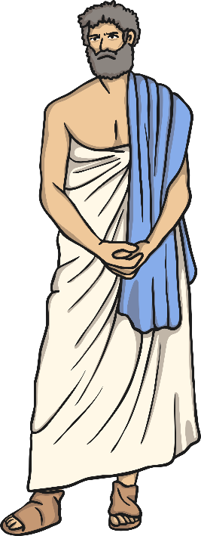
Democracy?
What is democracy?
What does it mean in the UK today?
Democracy is a fair political system where all adults vote for an elected government. This government then make decisions on how to run the country.
Adults in the UK vote in elections to choose a political party, MPs and the Prime Minister.

Slide 4
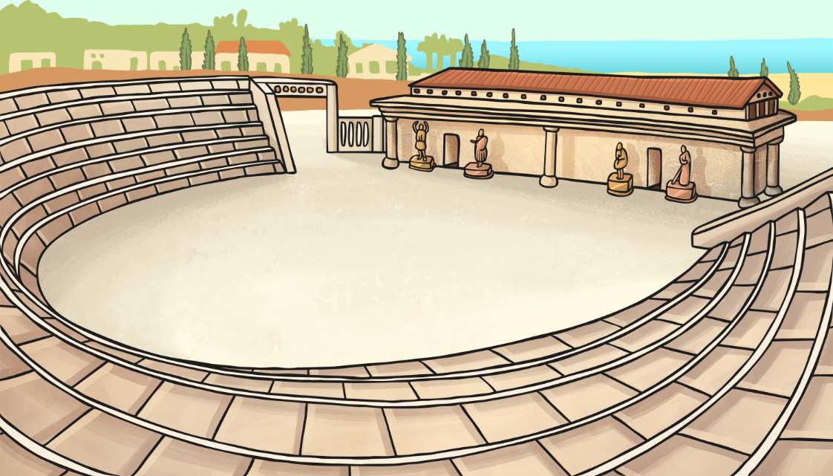
Where did democracy begin?
Democracy began in Ancient Greece. In fact, the Ancient Greek system is very famous and has helped to shape many systems of democracy around the world today.

Slide 5
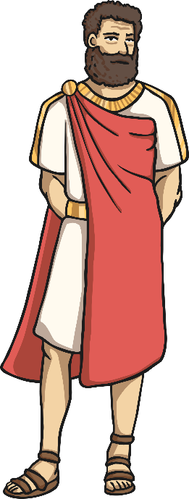
Democracy in Ancient Greece
There were three main systems of democracy in Ancient Greece:
The Ekklesia
The Boule
The Dikasteria

Slide 6
The Ekklesia
The ekklesia was the main assembly of citizens who met 40 times a year to make laws and decisions.
Any male Athenian citizen could attend.
Out of 40,000 men, about 5,000 attended regularly.
They made decisions by a simple majority vote.

Slide 7
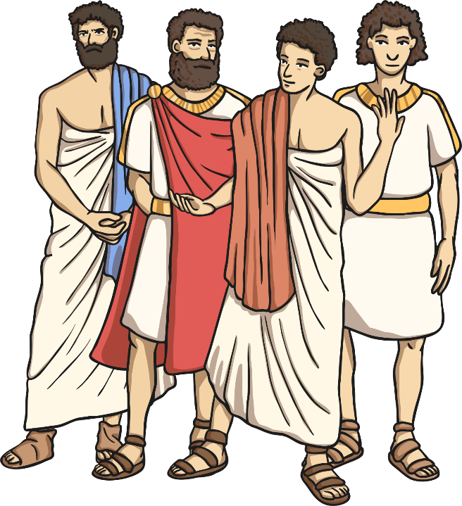
The Boule
The boule were a group of 500 men who served for one year. They met daily and made lots of decisions. They decided what issues to take to the ekklesia. They were chosen randomly.

Slide 8
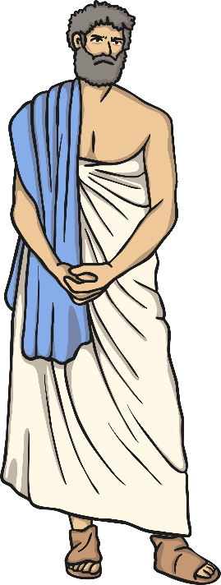
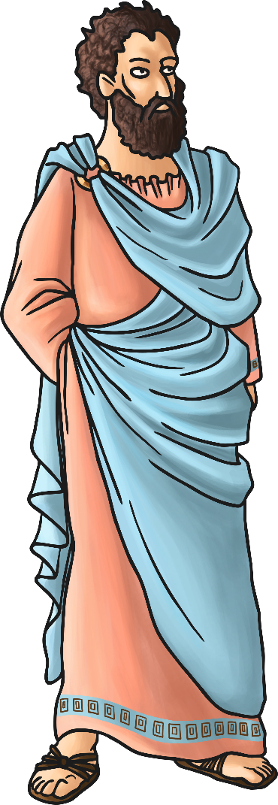
The Dikasteria
The dikasteria, or popular courts, was a group of 500 jurors who dealt with crimes. There were no rules or police so the dikasteria decided what would be tried and what the sentences would be. The jurors were chosen daily at random from a group of male citizens over 30 years old.

Slide 9
Who were a part of the democracy?
Men
Athenian
Citizens
Adults

Slide 10
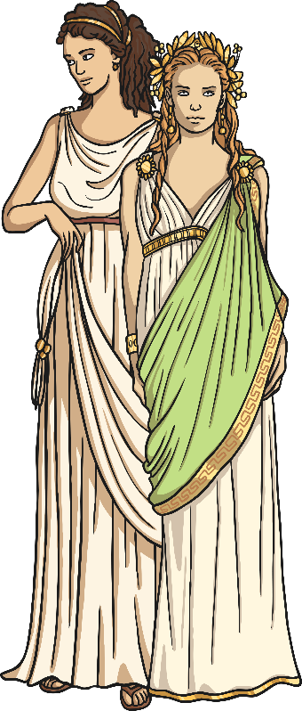
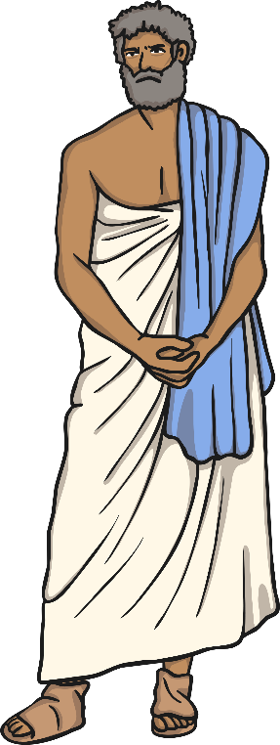
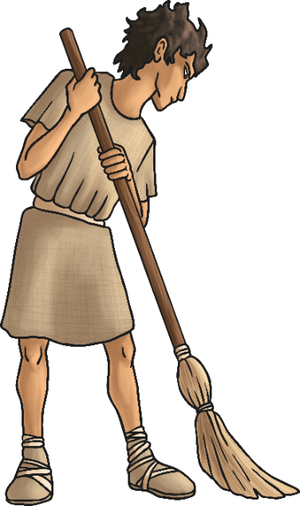
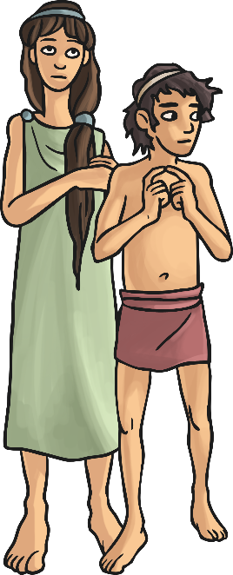
Who was left out of the democracy?
Metic (not Athenian citizens)
All women
Slaves
Children

Slide 11
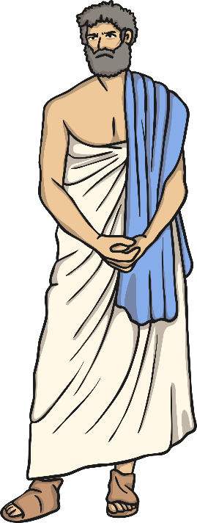
Who was included?
Look at the name cards on your tables. Sort the cards into two piles; those who are included in the democracy and those who are not.
Why have you sorted them like this?
Did we all agree?

Slide 12
Democracy Differences What are the main differences between democracy in Ancient Greece and democracy now?
Fill in the table on the activity sheets by listing the main differences between democracy in Ancient Greece and democracy in the UK now.
Ancient Greece | UK

Slide 13
Voting in the UK Should everyone in the UK today get the vote?
Who doesn’t have the vote?
Under 18’s
Prisoners
People who are not British Citizens
Should any of these groups be given the vote?

