Slide 2
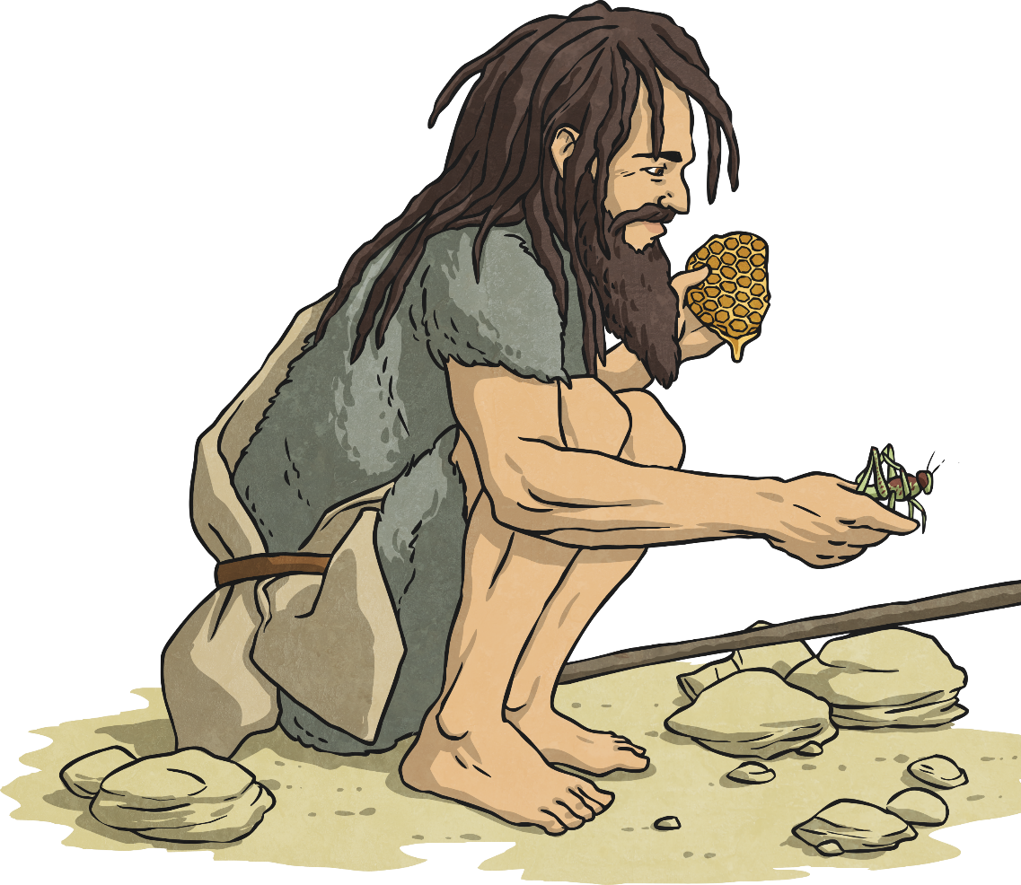
John the Baptist
There was once a man named John the Baptist.
He knew he had been born to be ‘set apart for God’. John devoted his life to encouraging people to repent of their sins and prepare them for the
coming of the Messiah.
The word ‘Messiah’ means The Lord.

Slide 3
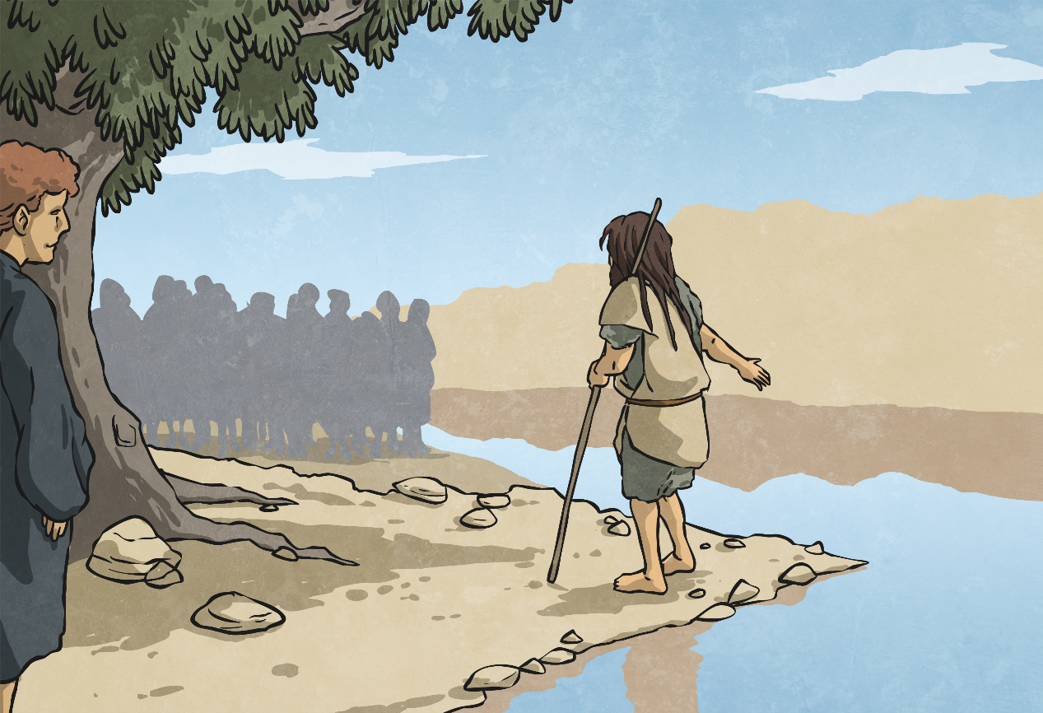
The Voice of Authority
John was not afraid to say what he thought. He had a voice of authority when he spoke and he used it to tell people to turn away from sin, and be baptised as a sign of repentance. People flocked to be baptised by him.
He said, “I baptise you with water for repentance. But after me will come one who is more powerful than I, whose sandals I am not fit to carry. He will baptise you with the Holy Spirit and with fire.”

Slide 4
The Baptism of Jesus
One day, Jesus came to the River Jordan to be baptised by John.
John did not feel he was qualified to do such an important thing and he said,
“I need to be baptised by you.”
Jesus replied, “Let it be so now. It is proper for us to do this to fulfil all righteousness.”
John finally agreed and baptised Jesus.

Slide 5
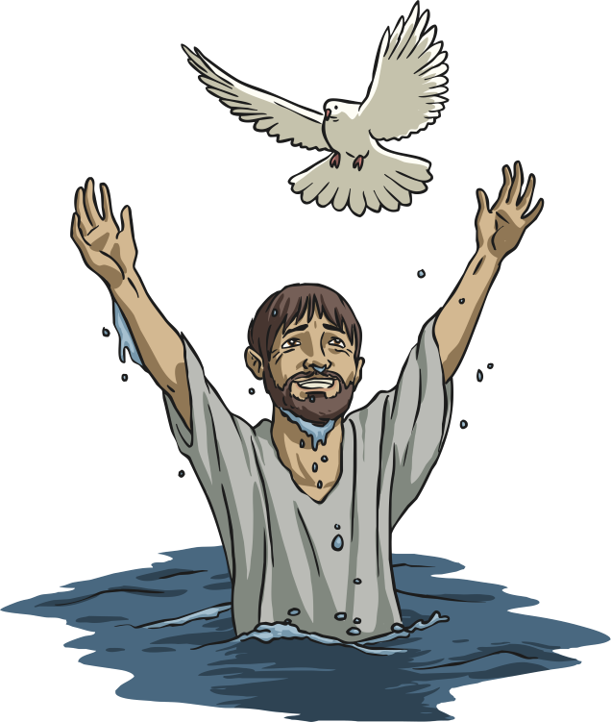
This is my Son
As soon as Jesus was baptised, the heavens opened and the Spirit of God came down like a dove. A voice from heaven said,
“This is my son, whom I love; with him I am well pleased.”

Slide 6
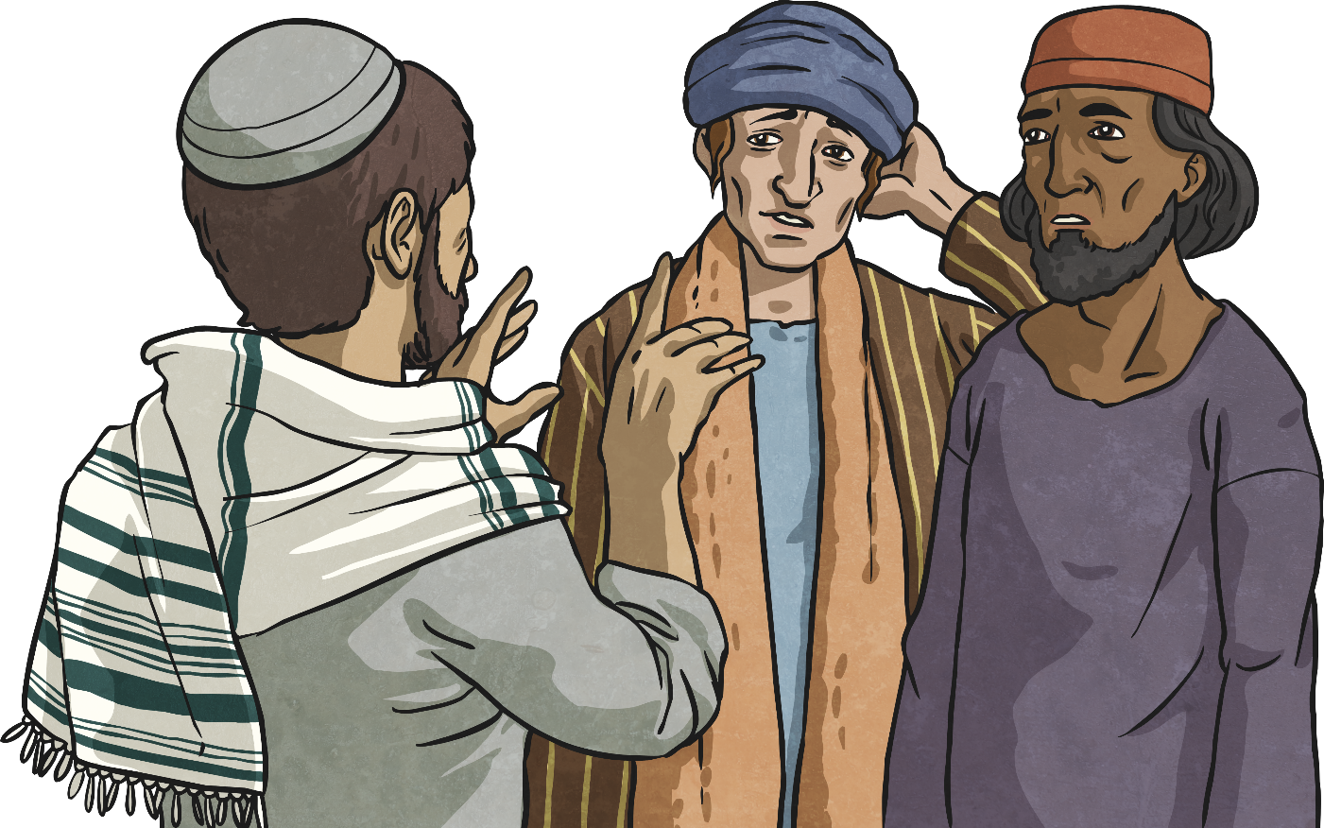
Why Was Jesus Baptised?
Despite being free of sin, Jesus was baptised for a number of reasons: being baptised before beginning his ministry shows that Jesus was being publicly recognised as the one John had spoken of, his baptism sets an example to his followers, and shows approval of John and the work he was doing.

