Slide 1
Week beginning: 18th May

Slide 2
Aim
I can describe the key features of a river system.
I can use atlases and maps to identify the key features of a river system.
Success Criteria
I can describe how water erodes a river bank.
I can describe how deposition changes the shape of a river.
I can tell you how meanders form.
I can tell you how an oxbow lake forms.
I can describe how waterfalls are formed.
I can identify meanders on a map and photograph.
I can identify oxbow lakes on a map and photograph.

Slide 3
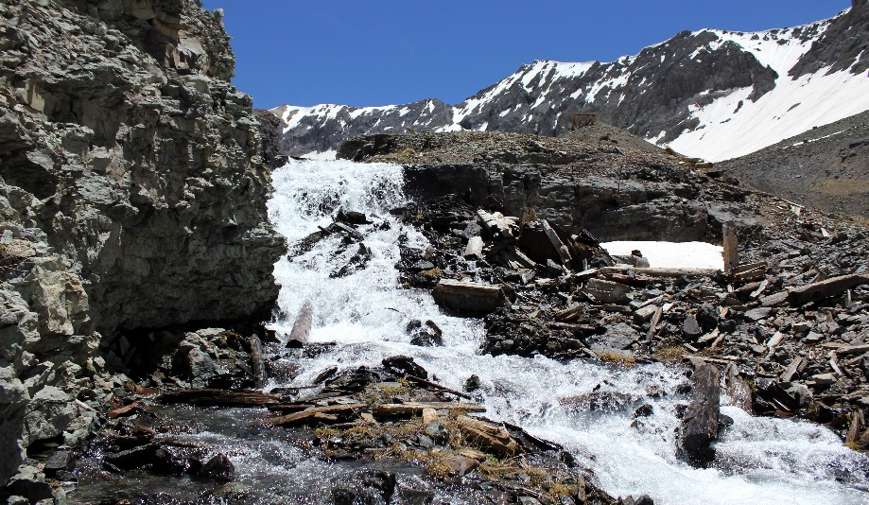
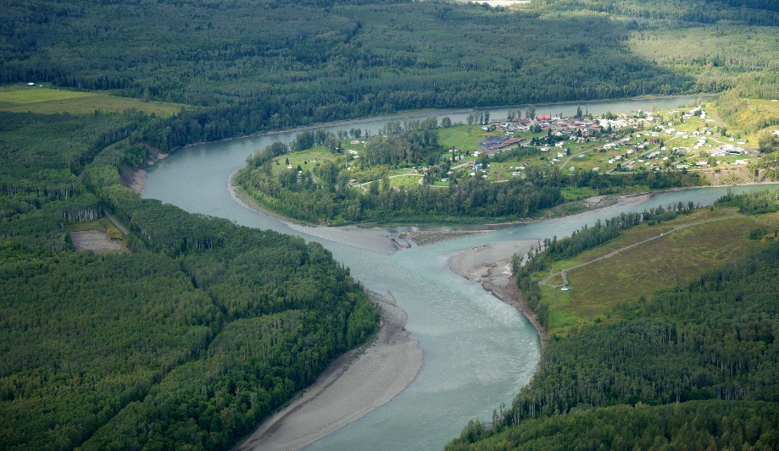
What Can You Remember?
Questions
What part of a river’s course is shown?
What features can you see?
How would you describe the river?
Speed
Features
Valley shape
Channel width
Photo courtesy of Sam Beebe, Ecotrust and VSELLIS (@flickr.com) - granted under creative commons licence - attribution

Slide 4
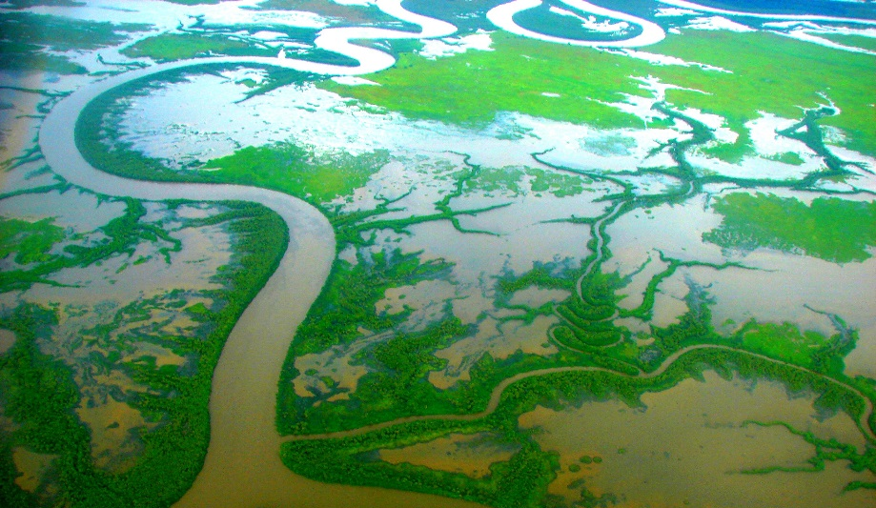
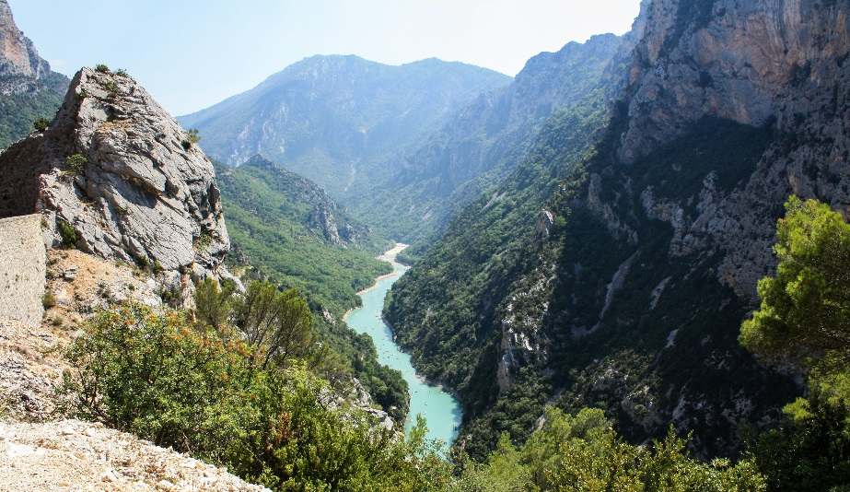
What Can You Remember?
Questions
What part of a river’s course is shown?
What features can you see?
How would you describe the river?
Speed
Features
Valley shape
Channel width
Photo courtesy of Sam Beebe, Ecotrust and VSELLIS (@flickr.com) - granted under creative commons licence - attribution

Slide 5
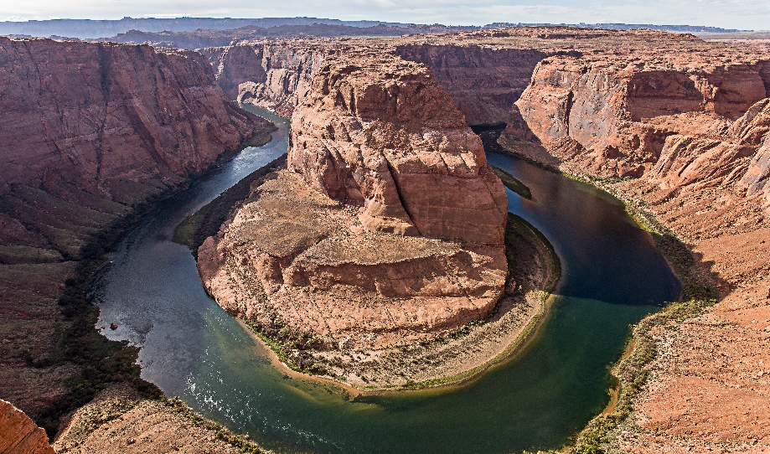
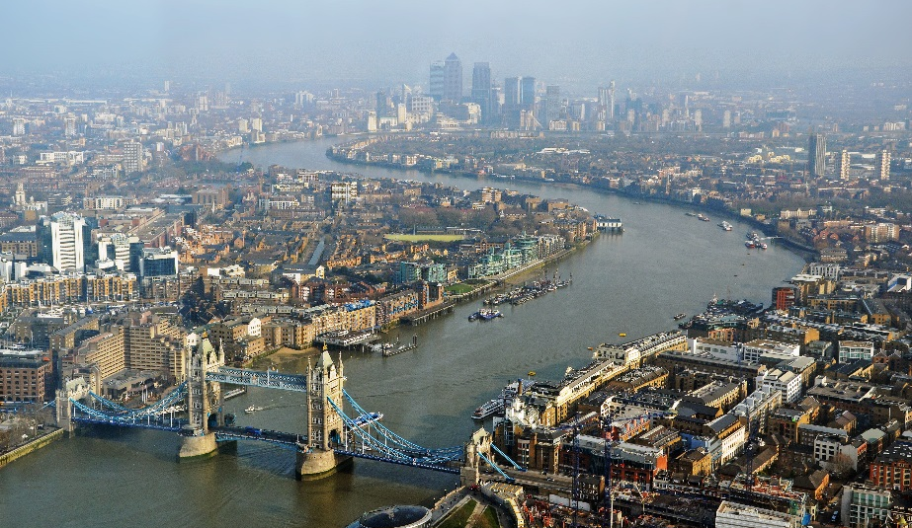
Erosion and Deposition
Why don’t rivers travel in straight lines?
They have to avoid obstacles as they flow downhill.
People have altered river courses over time.
Erosion and deposition can change the shape of a river.
What do you think erosion and deposition are?
Photo courtesy of DncnH and Andy Morffew (@flickr.com) - granted under creative commons licence - attribution

Slide 6
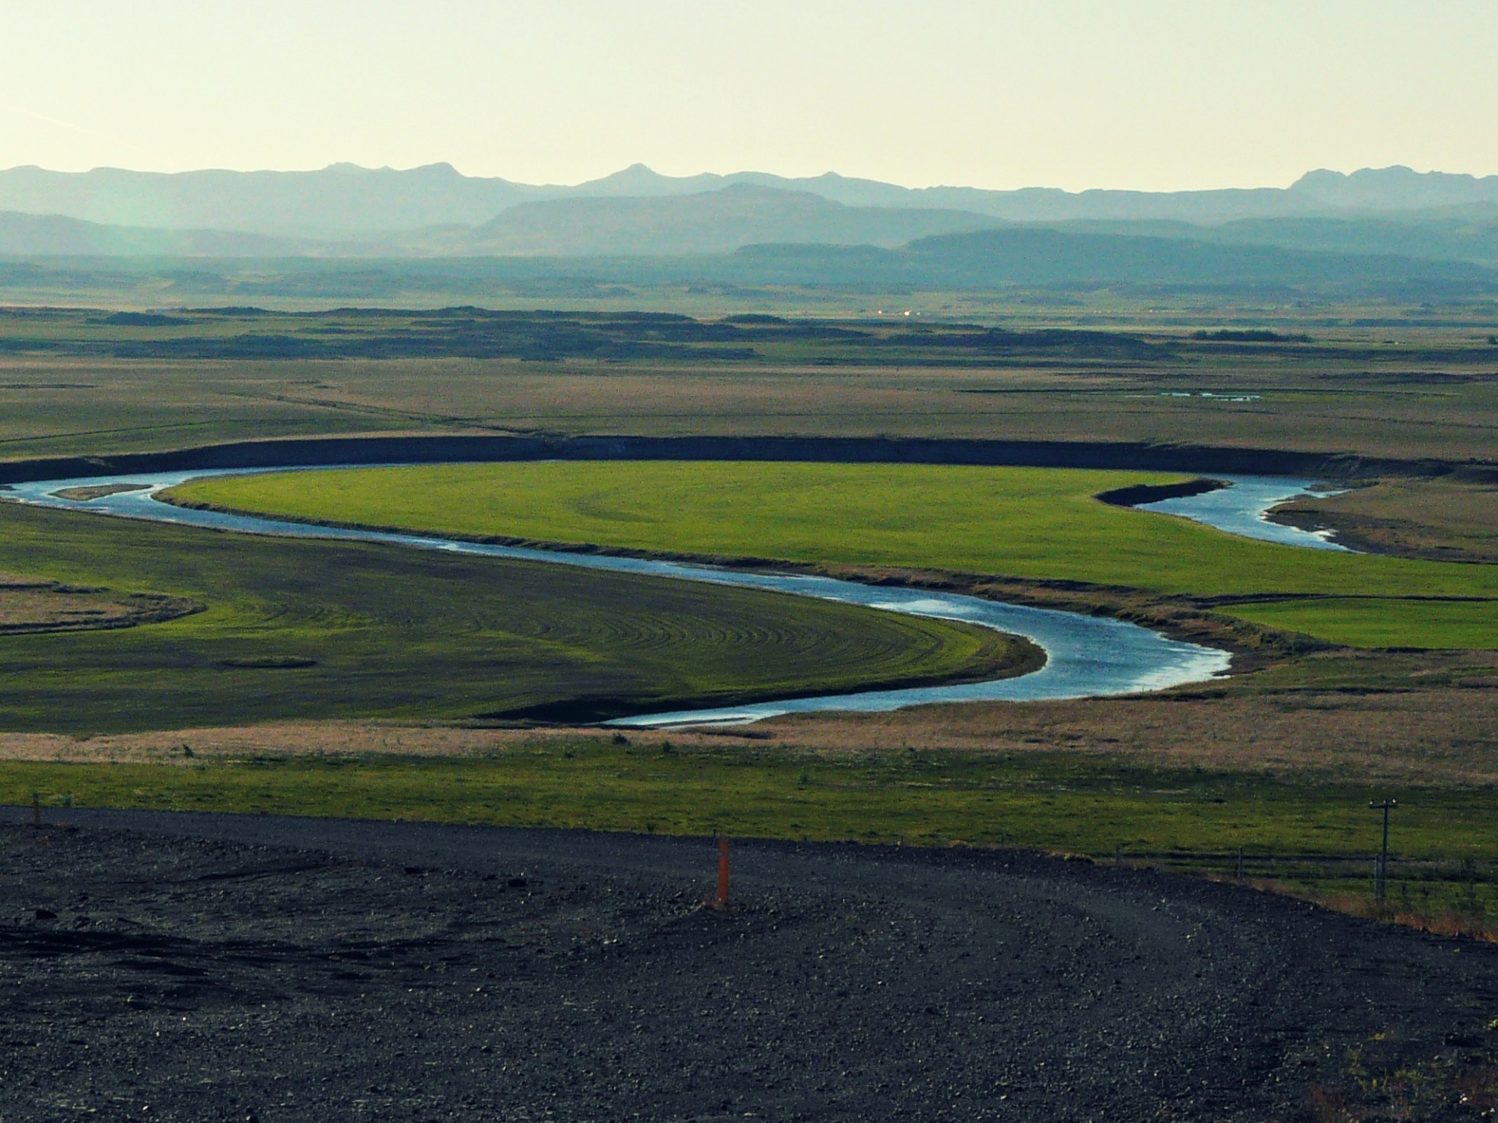
Meanders
Press the play button to watch this video which explains how meanders form.
Photo courtesy of MindsEye_PJ (@flickr.com) - granted under creative commons licence - attribution

Slide 7
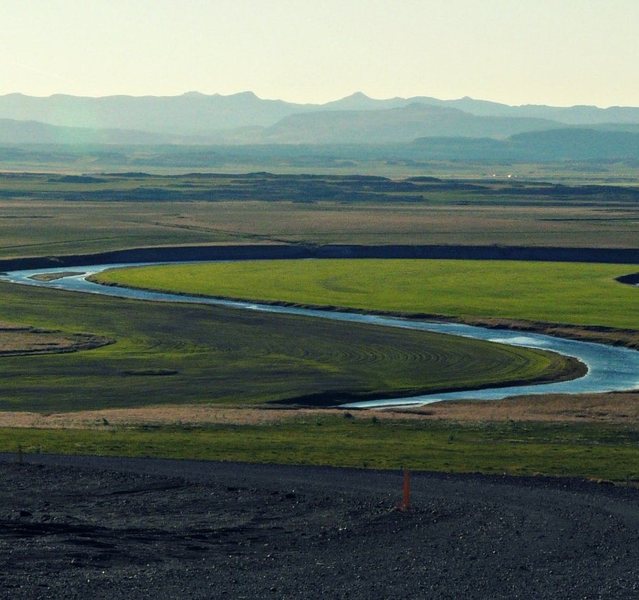
Oxbow Lakes
Watch this video which shows what happens to meanders over time:
As meanders grow, sometimes the water can erode away so much of the river’s banks that two meanders will merge together.
When this happens, the water will take this newer, shorter route and not travel around the previous course.
Over time, deposition of the river’s load will block off the old part of the river, and an oxbow lake will form.
Photo courtesy of MindsEye_PJ (@flickr.com) - granted under creative commons licence - attribution

Slide 8
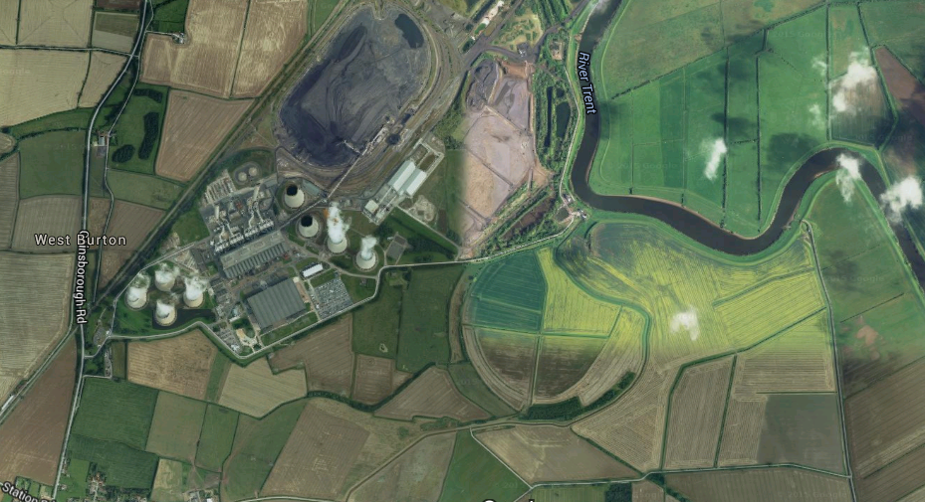
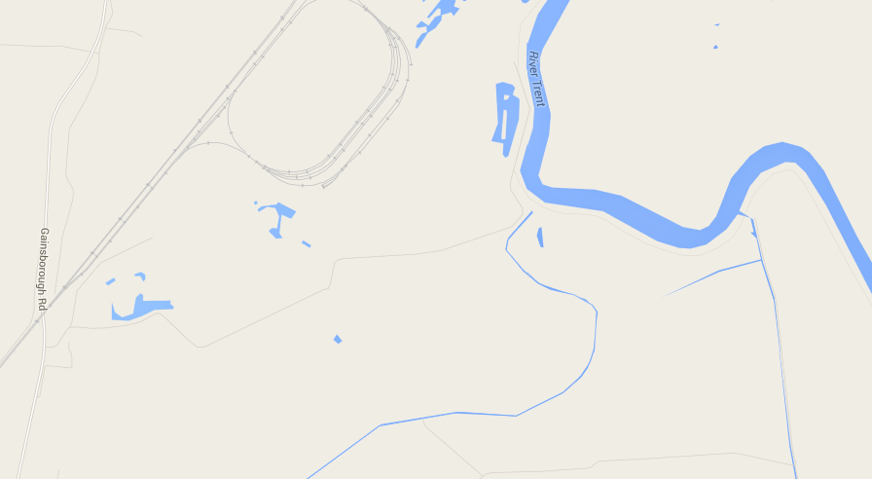
Oxbow Lakes
The map and aerial photograph show the same part of the River Trent.
Can you see the oxbow lake?
As the river no longer supplies the lake with water, it is not shown on the map.
Maps courtesy of Map data ©2015 Google

Slide 9
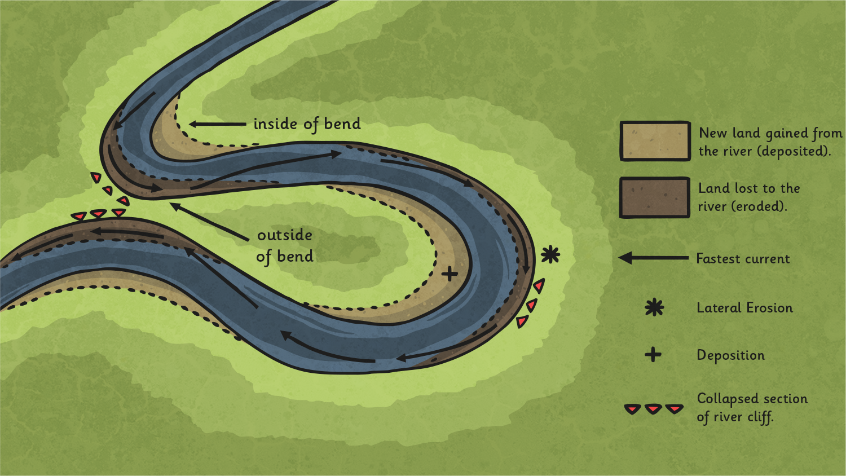
Let’s Make it Real
What happened: on the inside of the curve? On the outside of the curve?

Slide 10
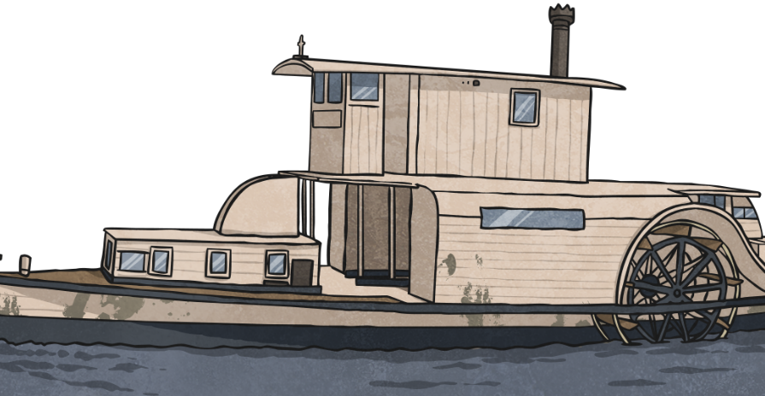
How Rivers Change Shape
Activity
Label your river diagram to show where erosion and deposition occur on the river.
Challenge: Can you annotate the maps to show where meanders and oxbow lakes are formed?

Slide 11
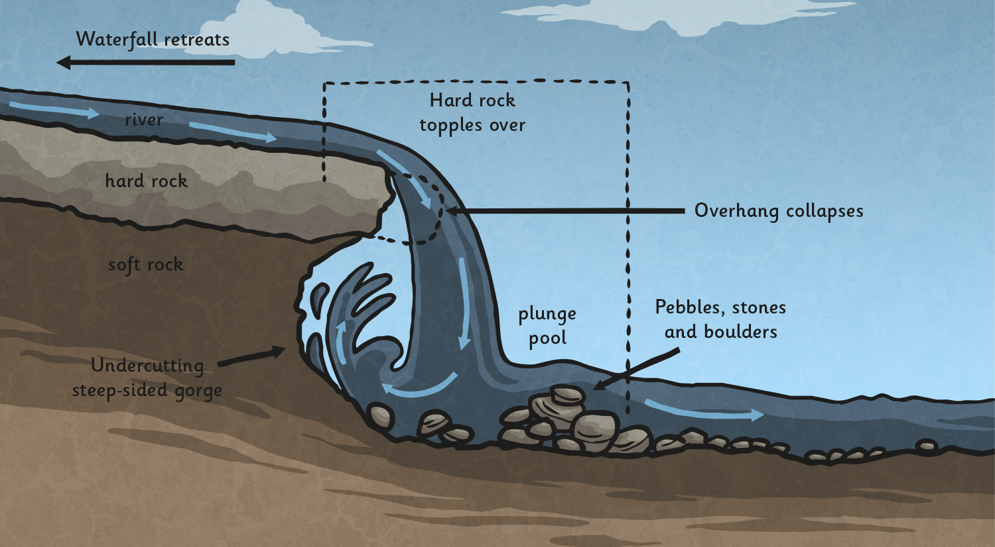
Waterfalls
What would happen to the shape of this waterfall over time?

