Slide 1
Emotions

Slide 2
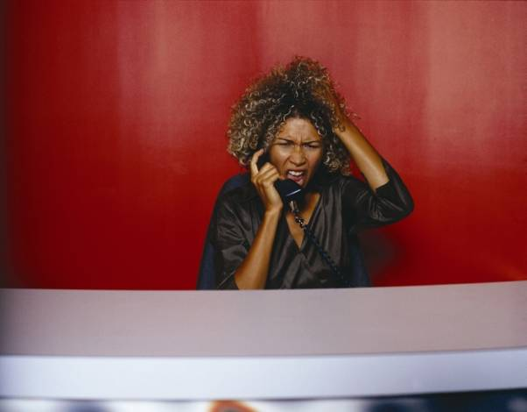
I don’t think it’s a good idea to talk now. She looks like she is feeling …………………
Angry

Slide 3
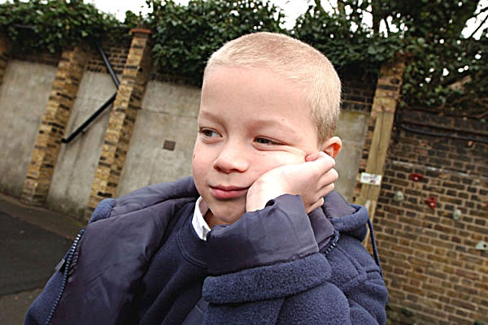
What a face. I think he needs to find something to do. He looks ………………….
Bored

Slide 4
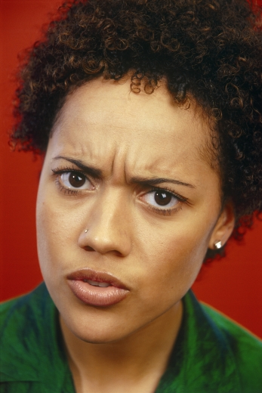
Maybe I should explain things more clearly because she looks …………………………
Confused

Slide 5
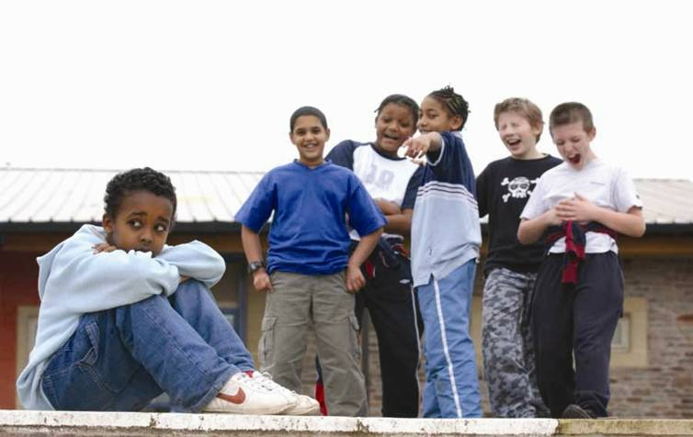
That group of boys are being horrible and they are making the boy sat down feel …………
Embarrassed

Slide 6
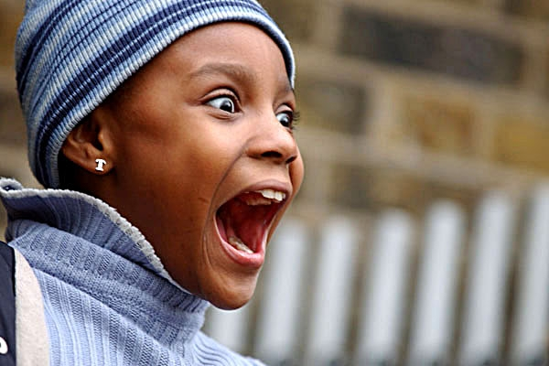
I think all her Christmas’s have come at once. She looks …………………..
Excited

Slide 7
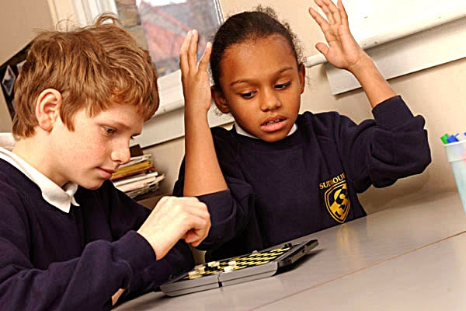
Something isn’t going right for someone. She is getting …
Frustrated

Slide 8
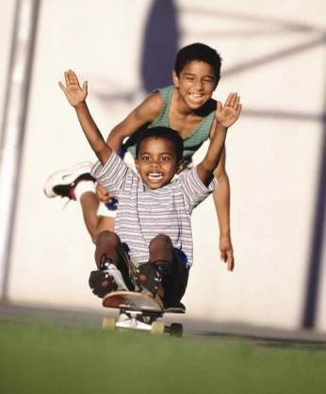
Wow this looks fun. Both the boys look …………
Happy

Slide 9
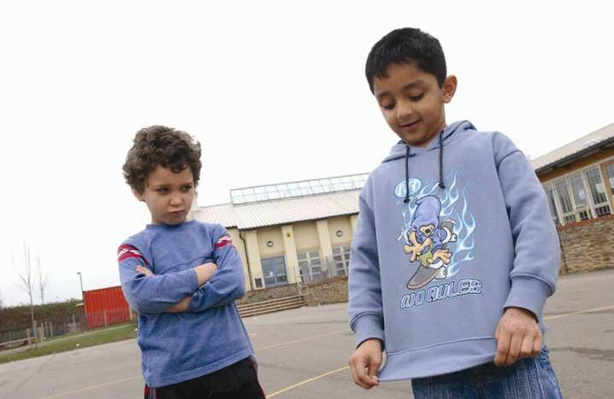
I think that the boy on the left wishes he had that top. He looks like he is feeling ………..
Jealous

Slide 10
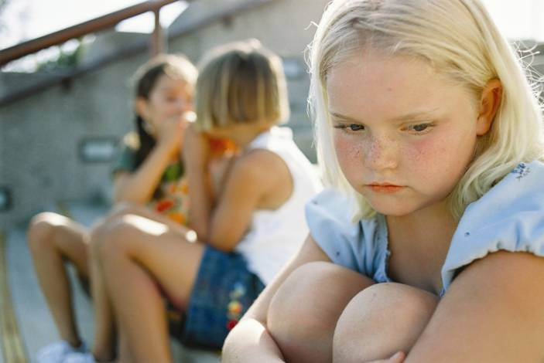
The other girls won’t let her join in. She is feeling ………………………….
Left out

Slide 11
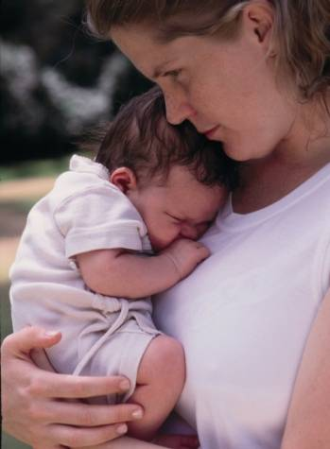
Look at this bundle of loveliness. This baby is feeling …………..
Loved

Slide 12
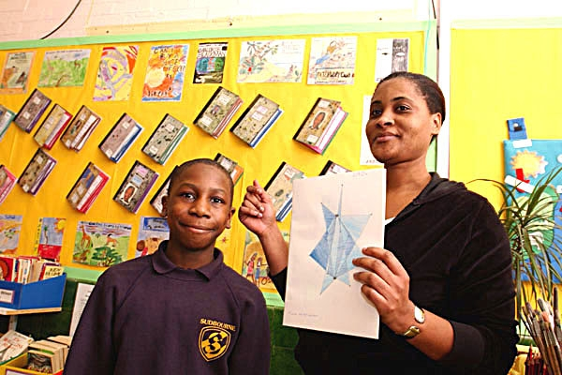
The teacher is showing everyone his work. I bet he feels ……………..
Proud

Slide 13
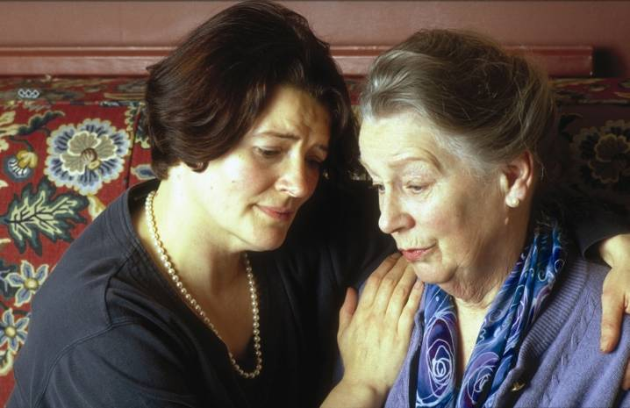
Oh dear I wonder what has happened. They both look …………..
Sad

Slide 14
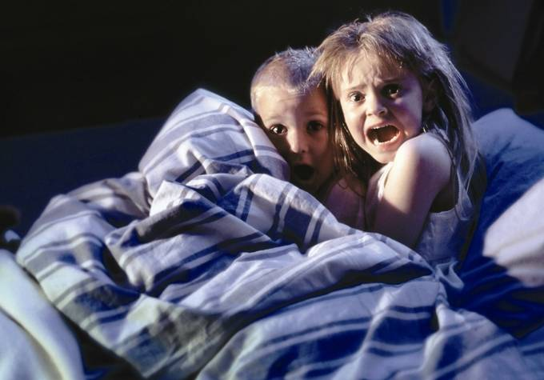
I think they’ve been watching horror films. They both look …………….
Scared

Slide 15
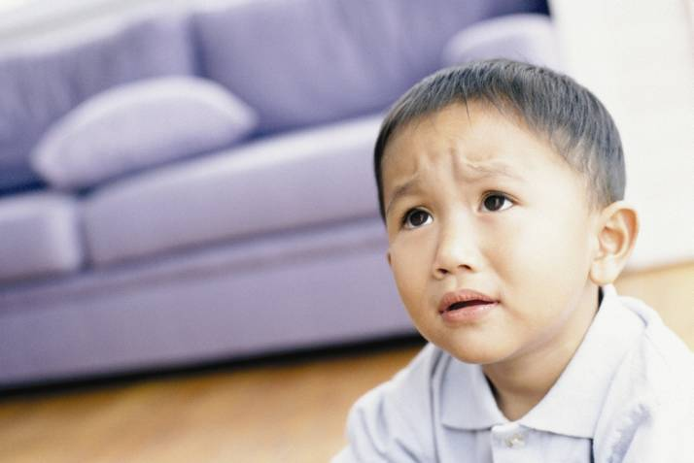
I think he has the weight on his shoulders. He looks ……………………
Worried

Slide 16
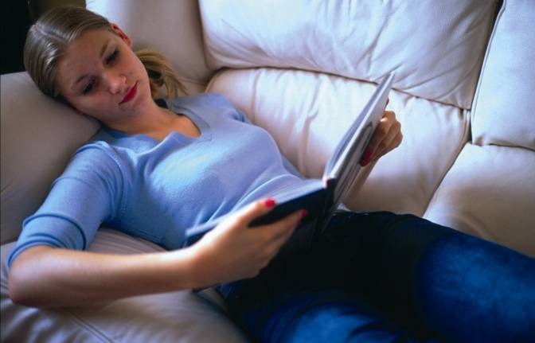
Not a care in the world, curled up with a good book. She looks …………………….
Relaxed

