Slide 1
Taste

Slide 2
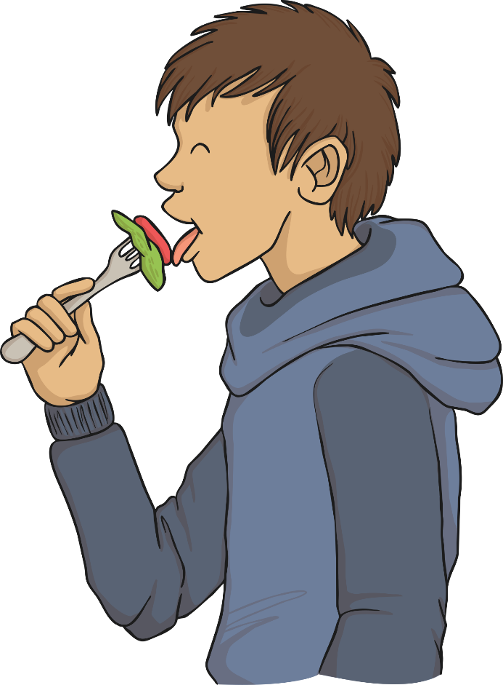
Learning objective:
I can name the 5 senses.
I can name parts of tongue.
I can discuss what we can do with this sense.

Slide 3
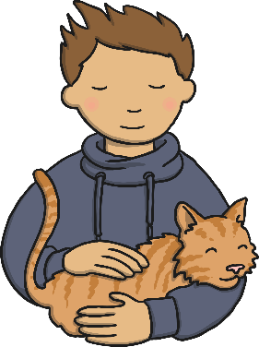
Senses

Slide 4
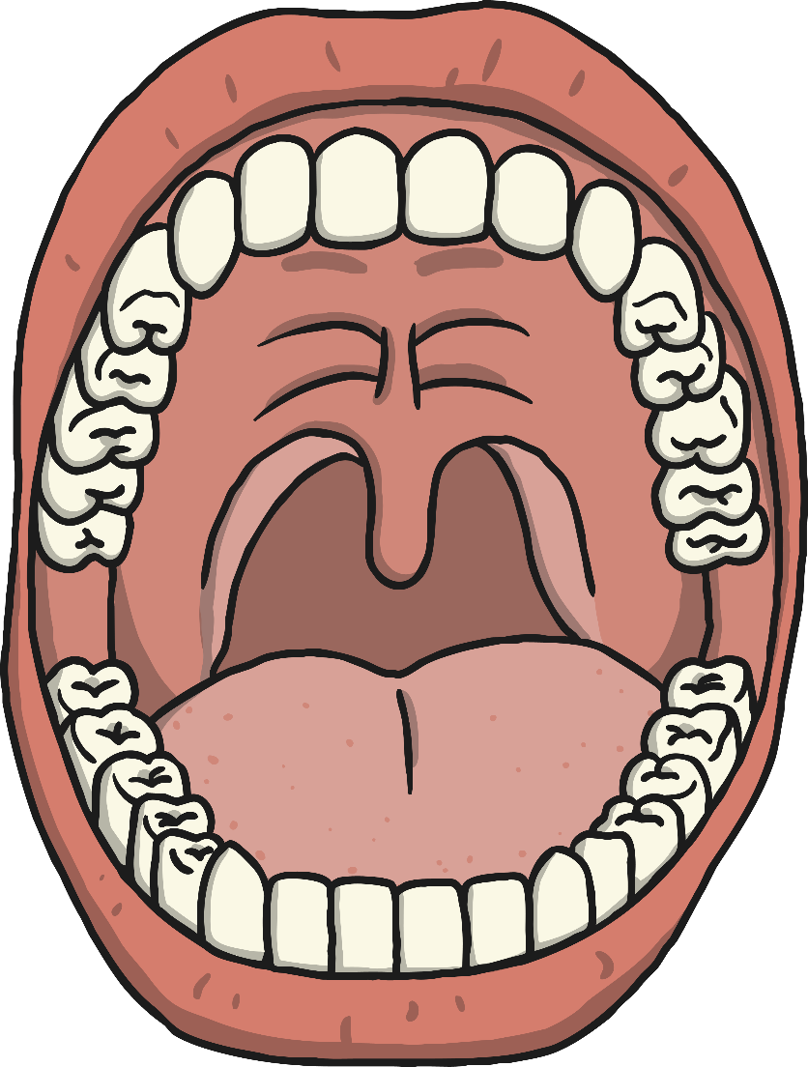
teeth
inside of cheek
palate
taste buds
tongue
lips
saliva glands
(under tongue)

Slide 5
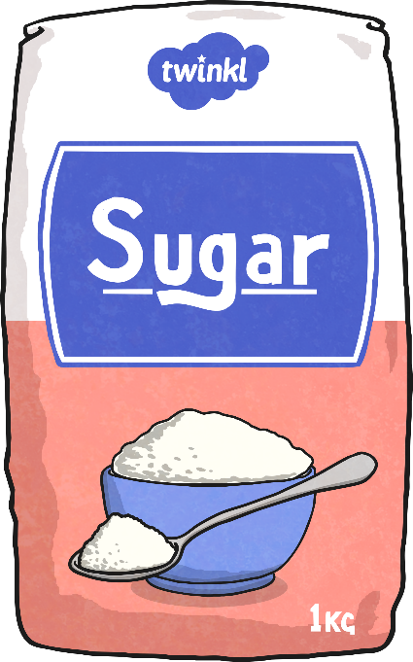
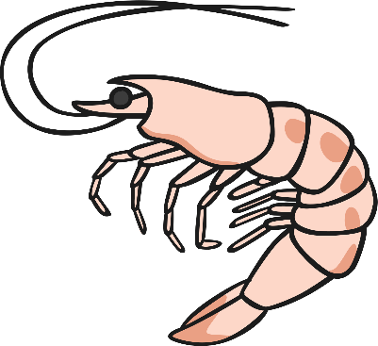
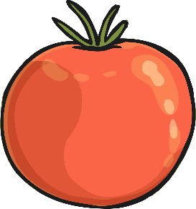
What part of our body do we taste with?
The tongue is not the only part of what we need , we need our noses to help too.
There are 5 basic tastes:
sweet
salty
bitter
sour
umami

Slide 6
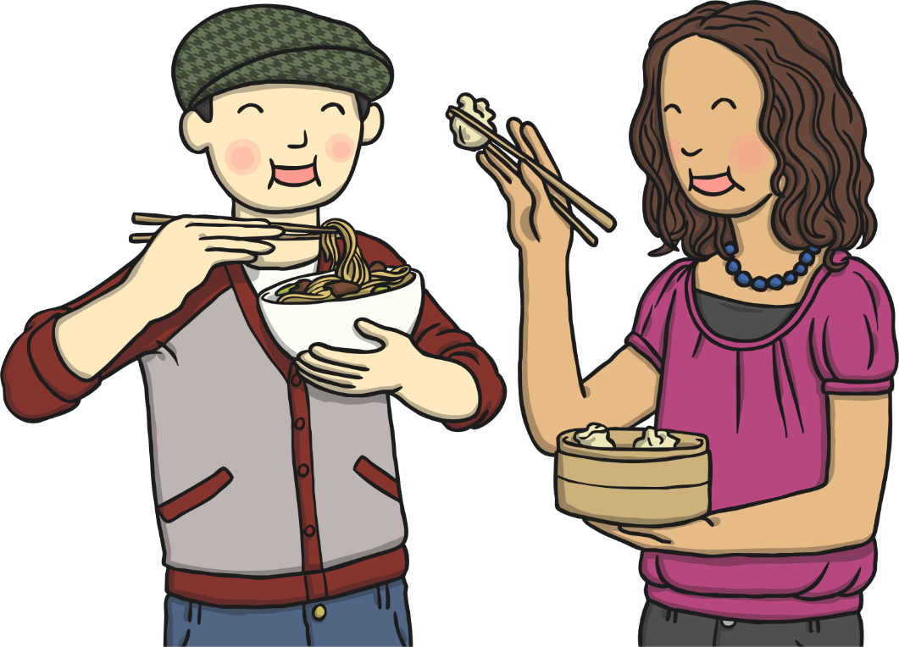
Tasting Task
Ask an adult if you can taste these five foods:
Lemon
Sugar
Dark chocolate
Pretzels or plain crisps
gravy
Investigate how good your tongue is at tasting the 5 basic tastes.
Decide which taste it is and write your findings on the worksheet.

Slide 7
Tasting Task
Which was your favourite flavour?
Which was your least favourite flavour?
Which flavours do you think would be nice to mix together?
This is the job of many chefs. They taste many different foods and try to mix new and different tastes together.

Slide 8
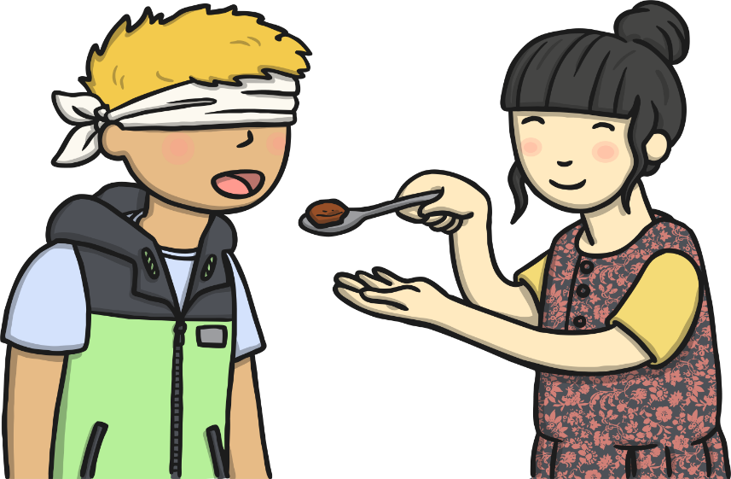
What have we learnt today?
Take this tasty quiz!
What do we need to taste our food? Name all 5.
What are the 5 different tastes?
Name 3 different parts of your mouth.

